Slide 1
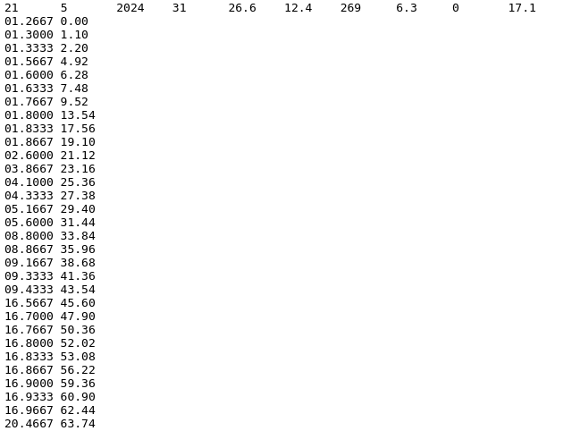
How DEP generates this, 626,609 times per day!
Daryl Herzmann
akrherz@iastate.edu
11 March 2025

Slide 2
Life Goals and Life Choices
Given that:
WEPP, our soil erosion model, outputs at a daily timestep.
We want to produce estimates of yesterday by the time old folks wake up in the morning (6 AM).
Within our model inputs, the weather information is updated daily.
We need complete/high resolution weather inputs available by 1 AM for previous day
For precipitation, we are bound to RADAR-based estimates (MRMS)
For other variables, we are bound to grid analyses (NCEP RTMA) or weather model analyses (HRRR)
A 0.01x0.01 degree grid is about the best that currently can be done.
For WEPP, we need to generate break-point climate/weather files.

Slide 3
Climate file daily text format
Avg Wind Direction [always zero for DEP]
Day
Month
Year
Solar Rad Langleys
High Temp C
# Breakpoints
Low Temp C
Avg Wind Speed mps
Avg Dew Point C
Breakpoint Precip
decimal time, Accum precip mm

Slide 4
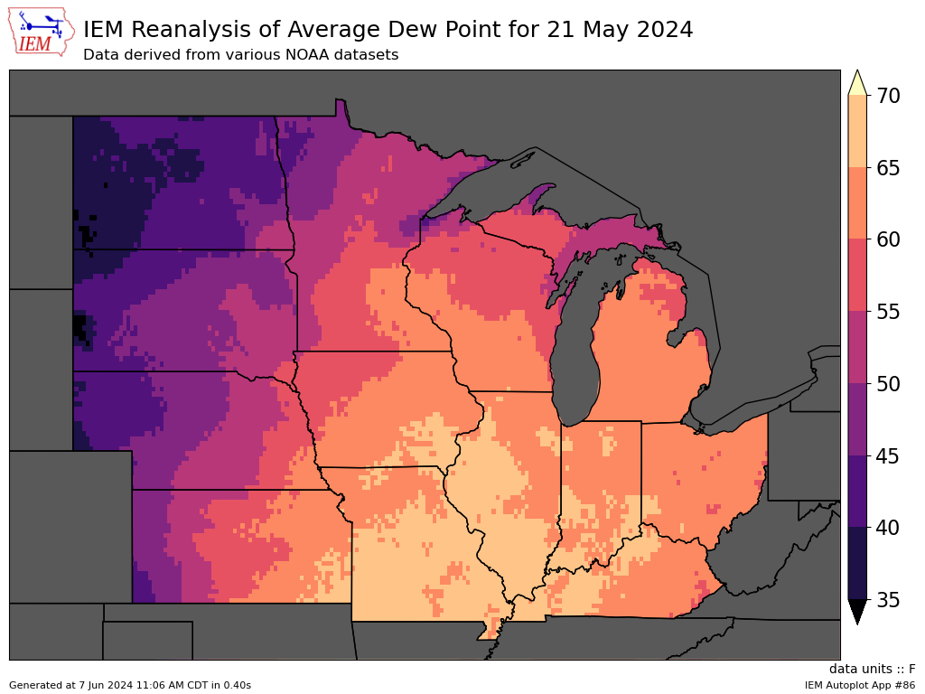
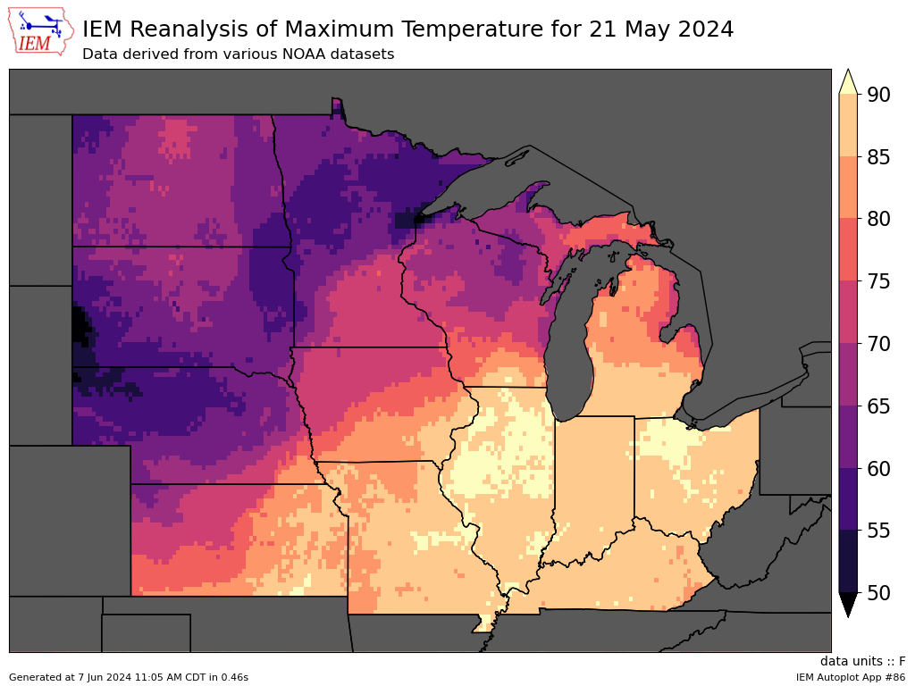
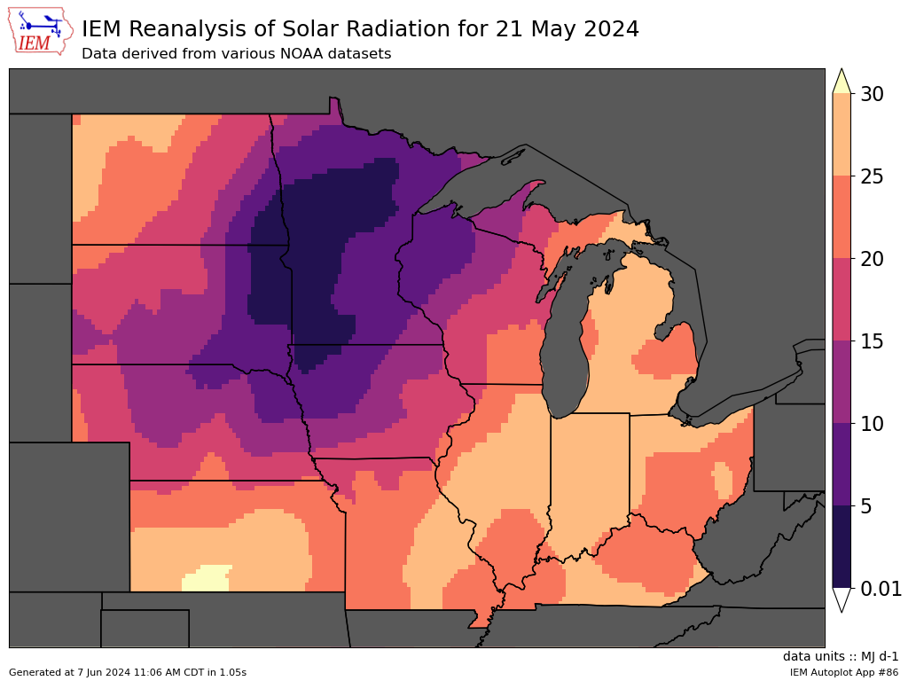
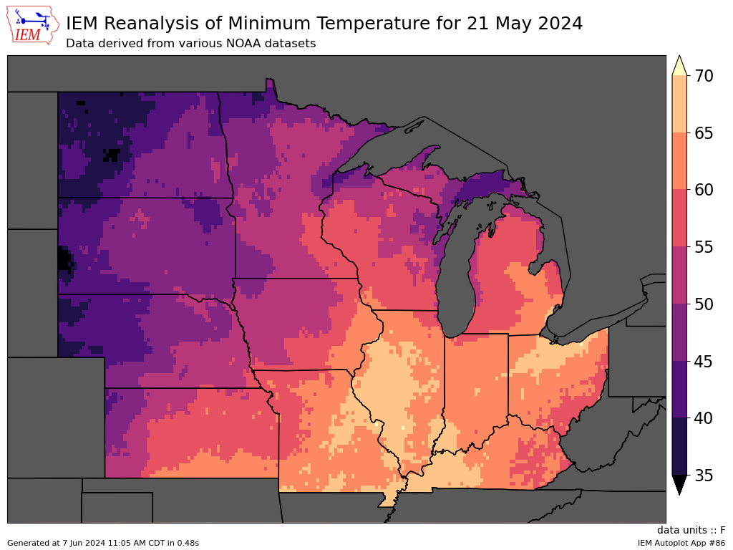
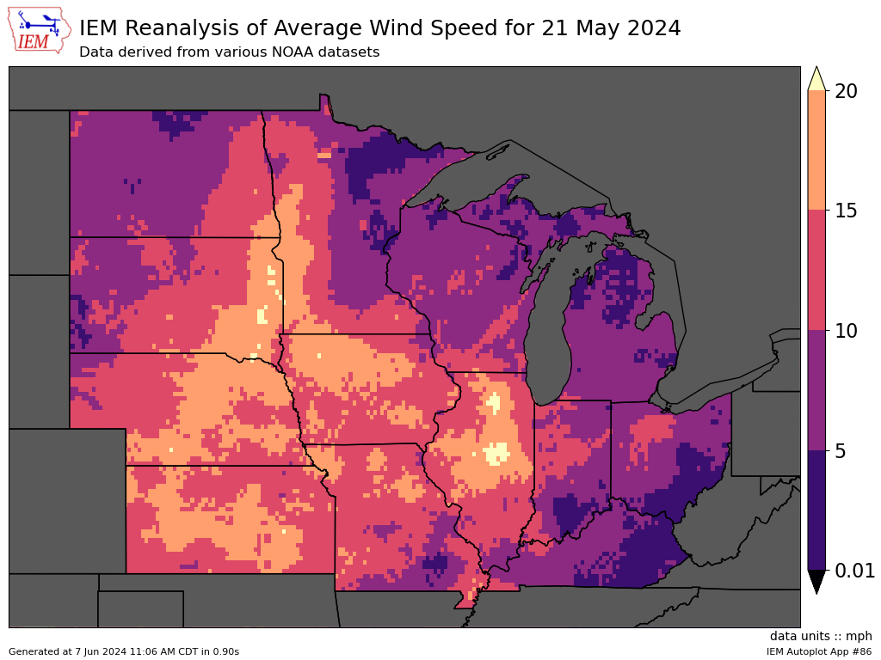

Slide 5
Breakpoint Generation Life Choices
WEPP has a breakpoint per day limit of 100, so we can’t feed it potentially 24x30=720 breakpoints
So the 2 minute data is consolidated such that
2 minute accumulations of >= 1 mm are retained
Every 2 mm of accumulation is retained
If this yields more than 100 points, we increment up the thresholds and try again until we get less than 100 points
NOTE: decimal time needs 4 digits to keep minute values precise to the second…

Slide 6
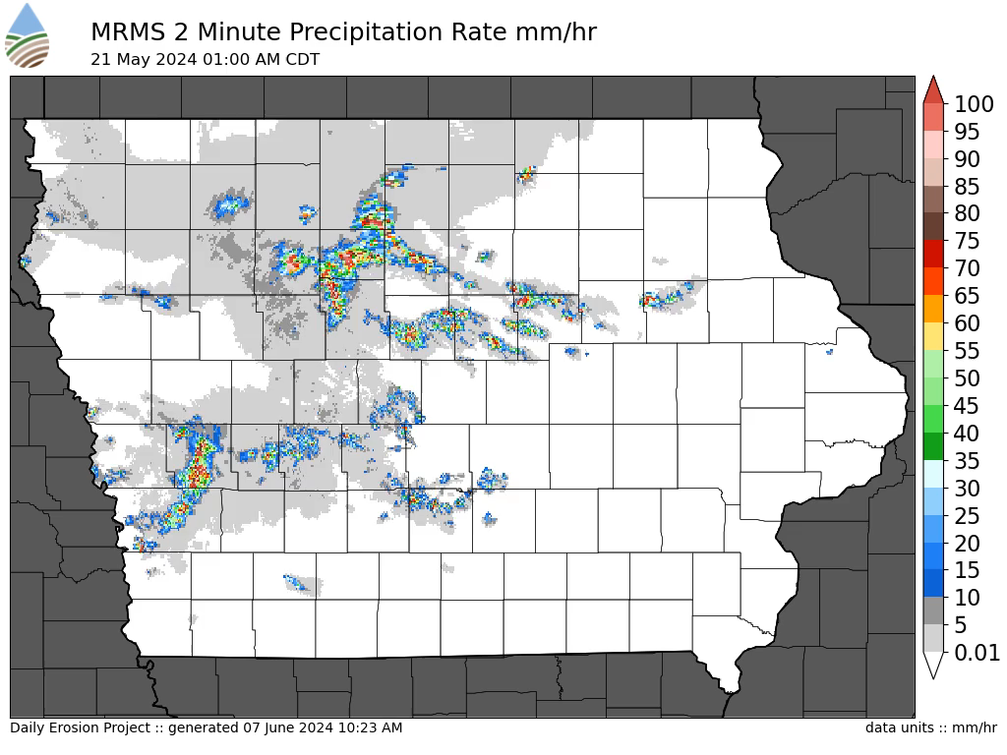

Slide 7
Scaling Pains
Presently, 8 CPU + ~32GB memory takes 20 minutes to process the 600k CLI files for a **single** given day.
This presents a problem when we bootstrap a new area, spinning up 19 years of climate files is non-trivial
So a 0.10x0.10 grid of climate files over land over the contiguous US (for areas we do not currently model) is maintained to allow a quick “warm-start”
Daily reprocessing selectively picks 17 previous dates and 10 days ago to regenerate all climate file data for those dates and reprocess erosion results. Precip data is more QC’d by then.

Slide 8
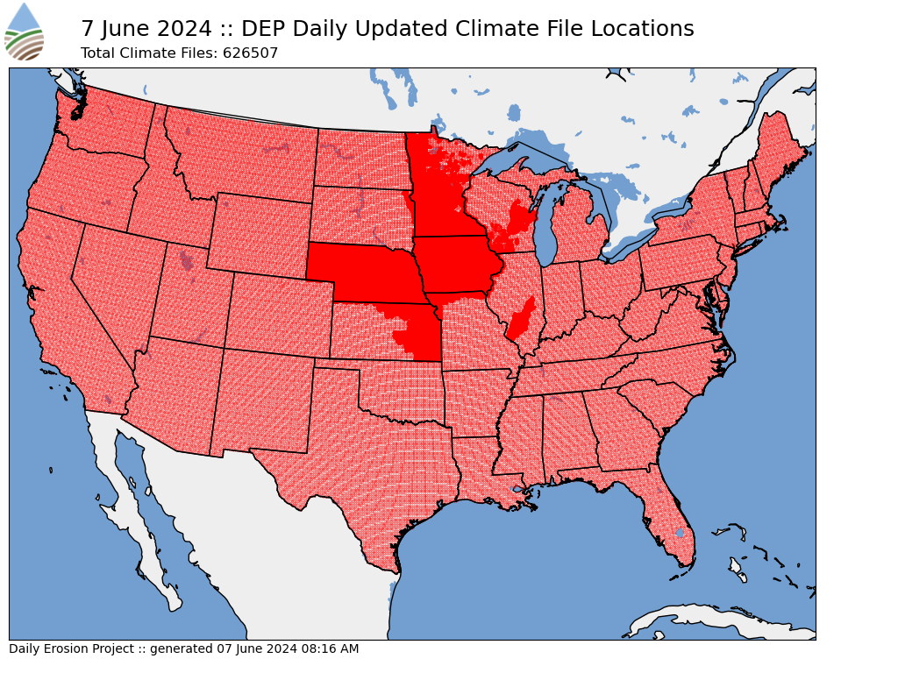

Slide 9
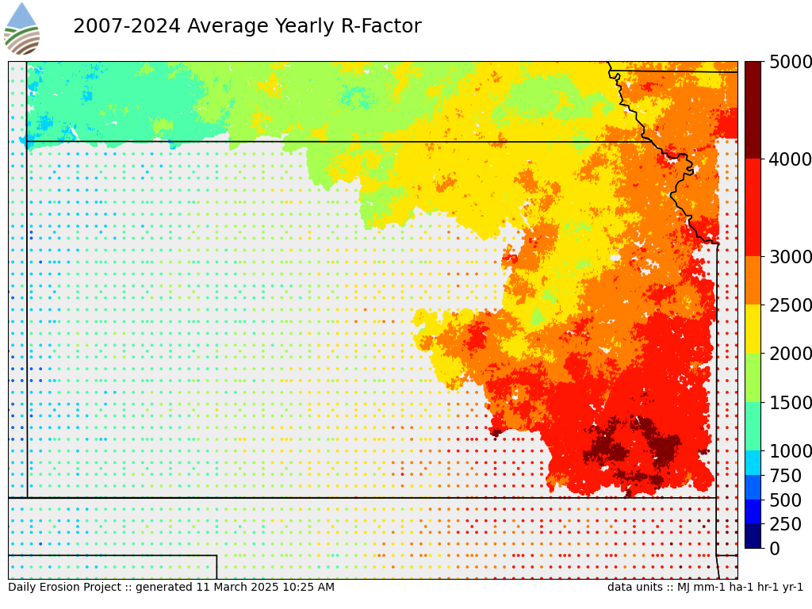

Slide 10
Part II: Running WEPP

Slide 11
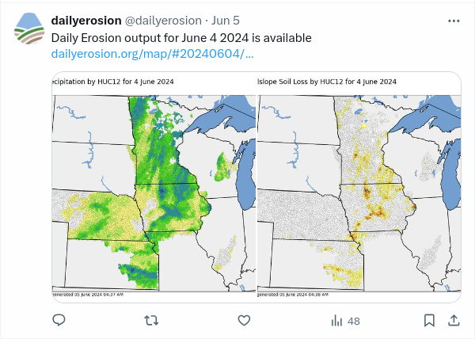
It is 1:20 AM, our climate files are all edited.
Now we need to run ~1 million WEPP hillslope runs
Thankfully
Each hillslope 19 year run takes about a second
We have about 70 distributed processors available that are listening to a central RabbitMQ server
So this processing finishes at about 4 AM.
Another 15 minutes to postprocess the output files, insert summarized information to the database.
We spam Twitter/X.

Slide 12
Part III: Dynamic Tillage & Planting

Slide 13
Back in the old days (IDEPv1, DEP<2024)
Spring tillage and planting dates were prescribed:
Based on a latitude based zonal grouping
Corn planted from 20 April till 10 May
Soybean planted from 12 May till 25 May
Tillage events spaced every five days prior to planting.
These hard coded dates do not well represent the year to year variability

Slide 14
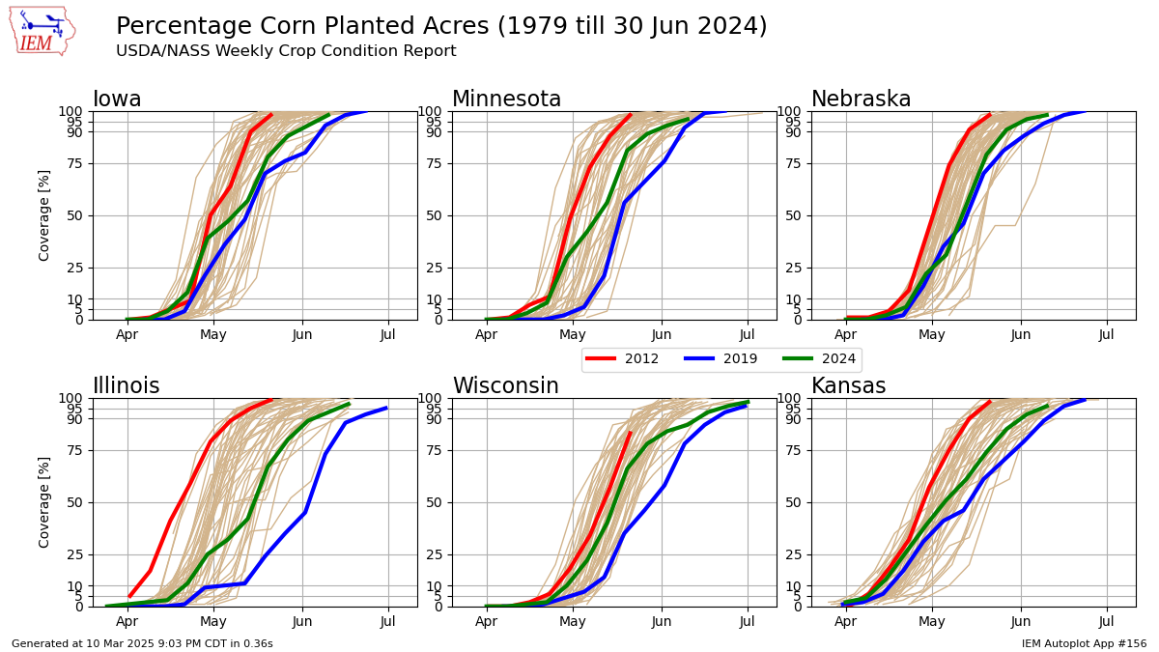

Slide 15
Data driven spring tillage/planting date algo
Each day between 11 April and 15 June, each HUC12 is evaluated:
Based on previous day’s DEP run, are at least 25% of modelled OFEs below 80% of the plastic limit.
Based on NWS forecast model (GFS), are average 0-10cm soil temperatures expected to average above 6C over next 3-7 days
Based on precipitation estimates up till 6 PM, did less than 10mm of precipitation fall
If all three of those checks pass, then
Up to 10% of ag acres of the HUC12 are tilled
Up to 10% of ag acres of the HUC12 are planted (excluding fields just tilled)

Slide 16
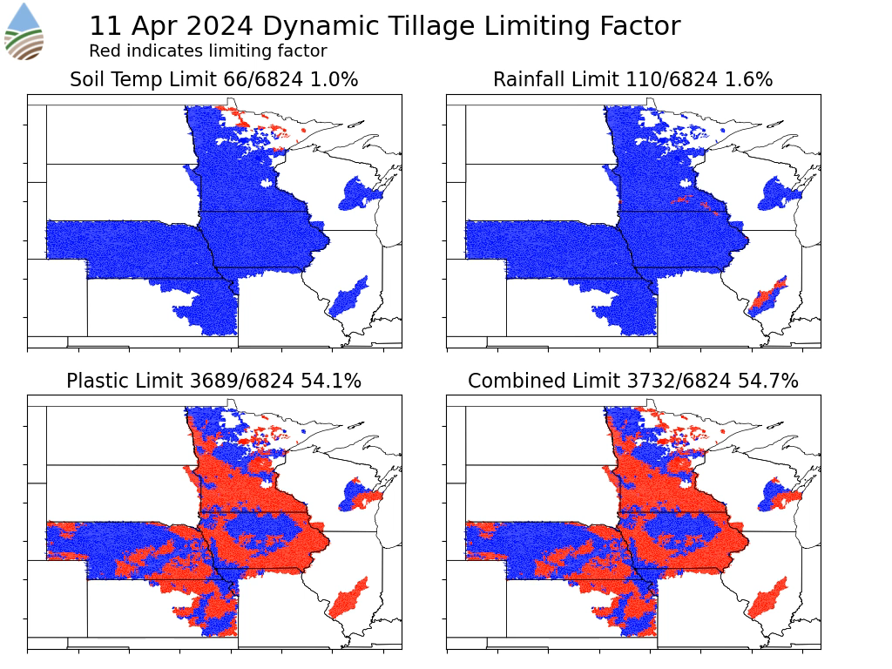

Slide 17
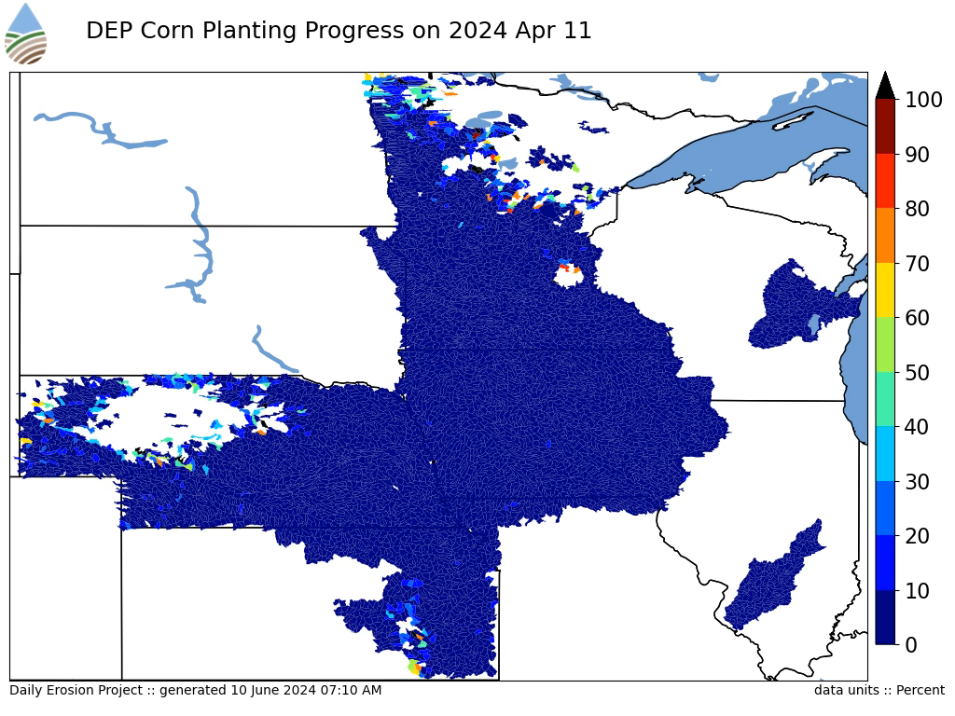

Slide 18
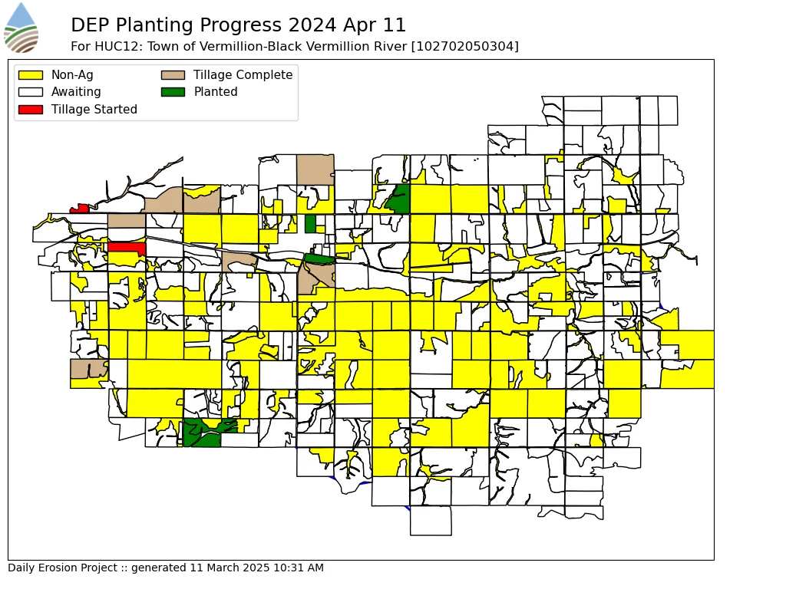

Slide 19
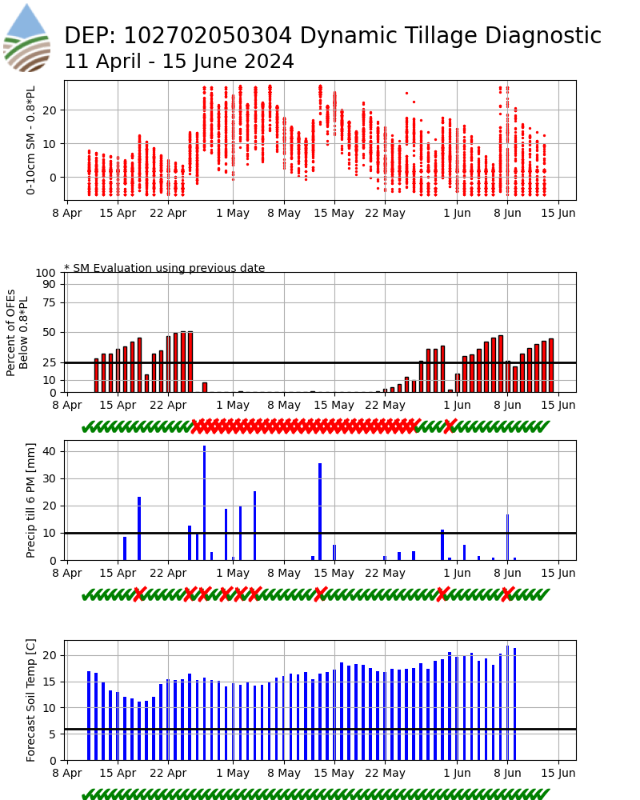

Slide 20
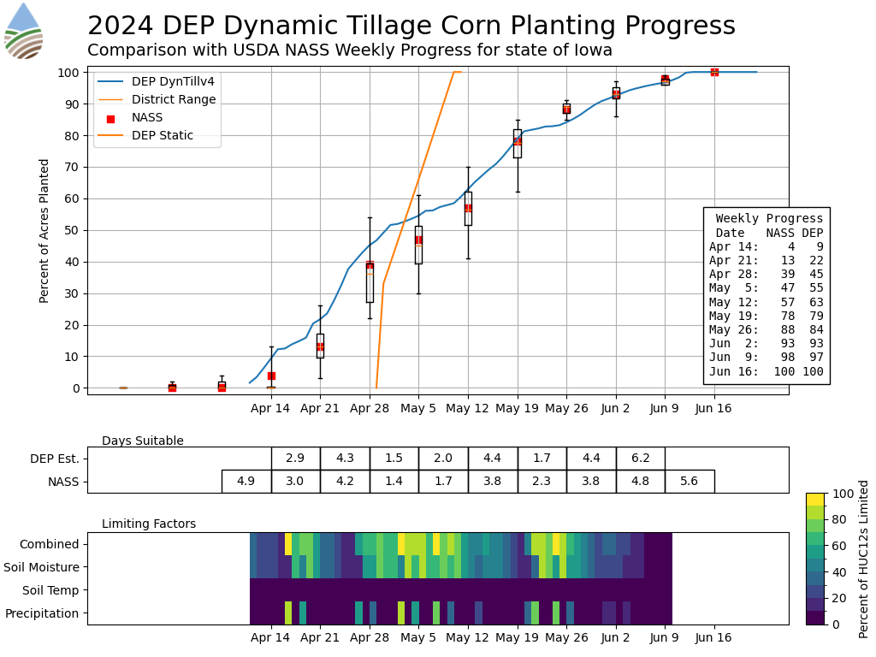

Slide 21
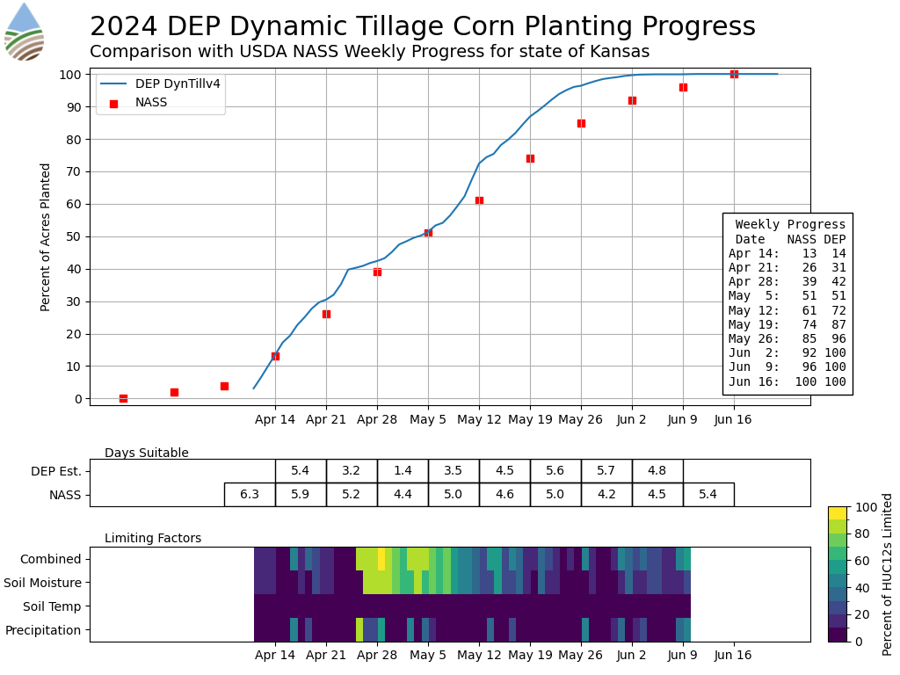

Slide 22
Nothing more to see here. The model is predicting perfectly….

Slide 23
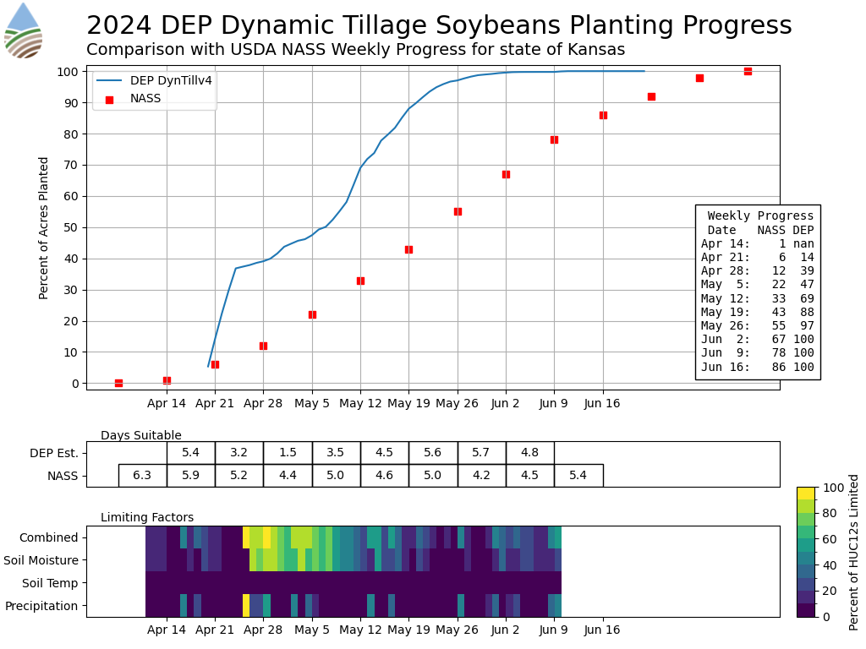

Slide 24
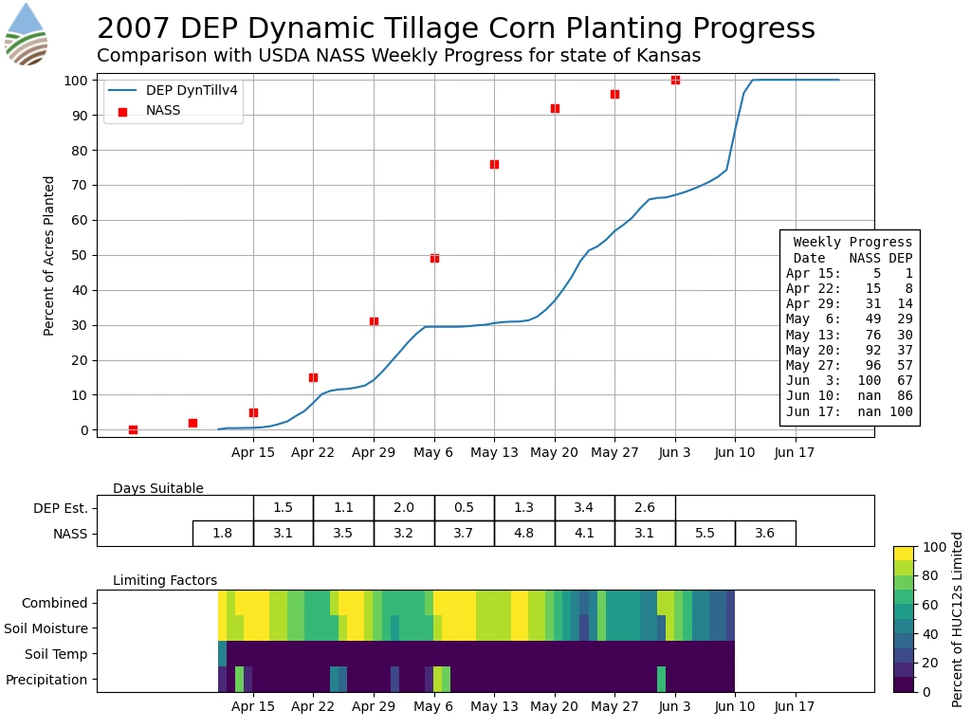

Slide 25
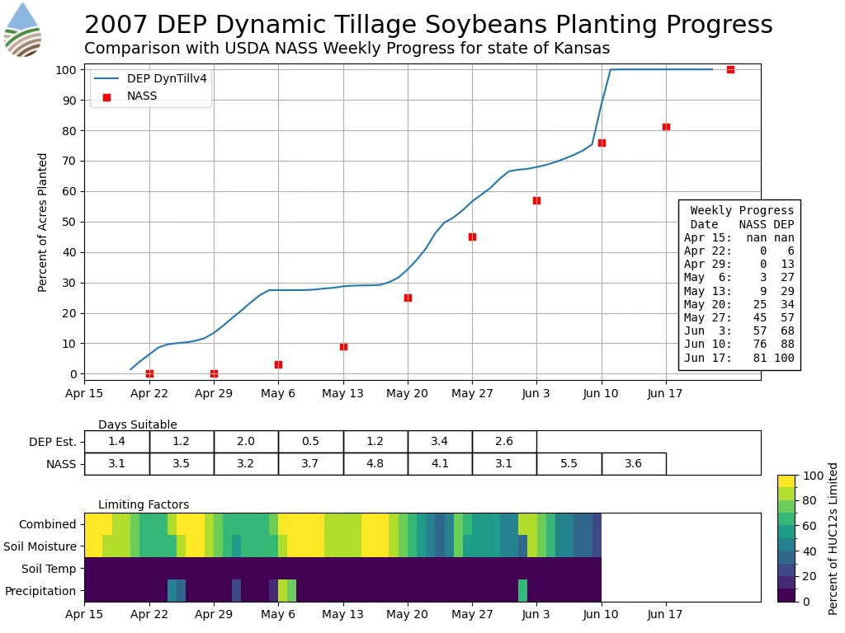

Slide 26
